Slide 1

Programming Concepts and Languages
Pramod Nikam
Technology Specialist, Cognizant

Slide 2
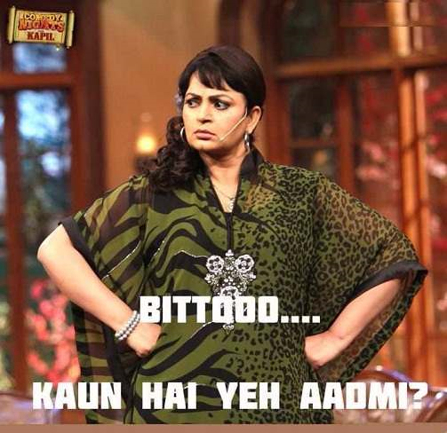
Lets have some quiz
How many Can you identify???

Slide 3






Easy To Hard ……

Slide 4
Programming Languages
Machine Level Languages
Example :- Basic , C ..
Assembly Languages
Example :- X86 ..
High Level Languages
Example :- Java, C# , Ruby ..

Slide 5
Programming Styles
Declarative Programming :-
In a declarative programming style you describe the results that you want, but not how to get there.
e.g SQL
Imperative programming
Imperative programming is a programming paradigm that uses statements that change a program's state. In much the same way that the imperative mood in natural languages expresses commands, an imperative program consists of commands for the computer to perform. Imperative programming focuses on describing how a program operates. E. Fortran , COBOL
Procedural programming : More To Come
Object Oriented Programming : More to Come

Slide 6

Procedural Languages
Lets Discuss procedure to prepare Tea…

Slide 7
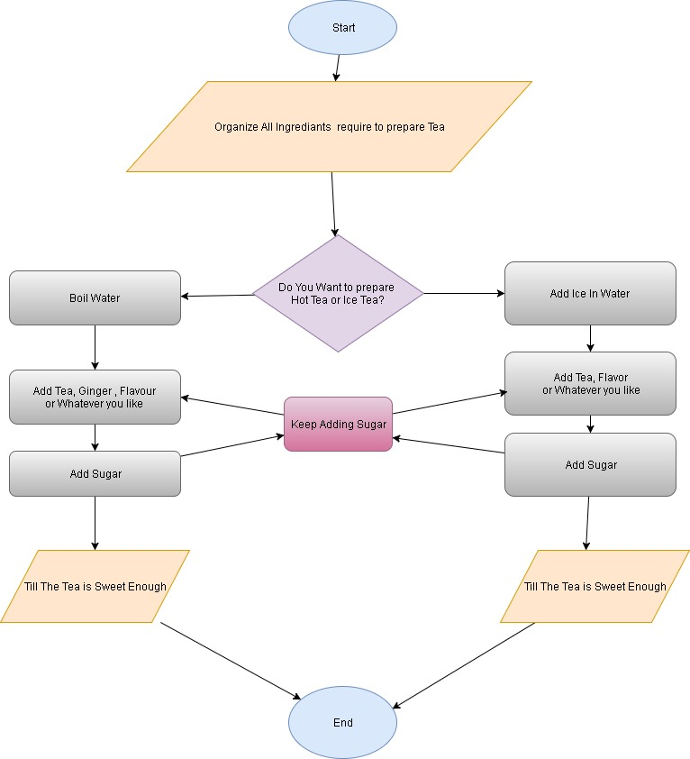

Slide 8
Algorithm , Pseudo Code and Program
Algorithm :
Step 1 :- Collect All Ingrediants
Step 2 :- Pour Water In Kettle
Step 3 :- Boil Water
Step 4 :- Add Tea , Ginger , Milk etc
Step 5 :- Serve it with smile ☺

Slide 9
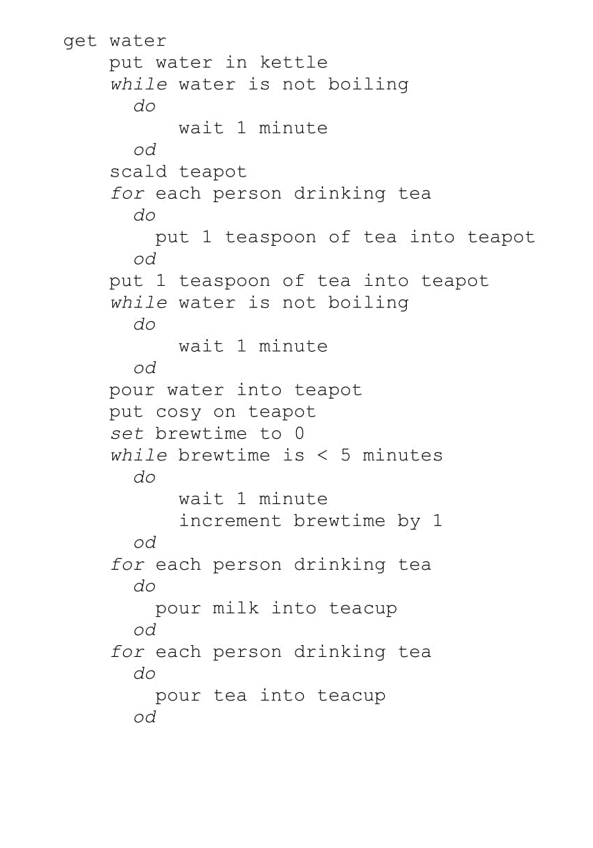
Pseudo Code

Slide 10

Actual Code
Do It Yourself!!!!!
Lets try everybody’s favorite language C for this purpose.

Slide 11
Object Oriented Programming AKA OOPS
What is OOPS?
This is what wikipedia says:
Object-oriented programming (OOP) is a programming paradigm based on the concept of "objects", which may contain data, in the form of fields, often known as attributes; and code, in the form of procedures, often known as methods.
☺ Relax ! It is not that Complex !!

Slide 12
Why To Use OOPS
More Modular Design
Code comprehension is at its best in OOPS.
Save development time (and cost) by reusing code
once an object class is created it can be used in other applications
Easier debugging
classes can be tested independently
reused objects have already been tested.
Easy to Maintain
OOP makes it easy to maintain and modify existing code as new objects can be created with small differences to existing ones.
Data Safety
Data is safe and secure, with less data corruption, thanks to hiding and abstraction

Slide 13
Object Oriented Paradigm
(Paradigm: a way of seeing and doing things)
Object - Oriented (OO) Programming:
Organizing software as a collection of objects with a certain state and behavior.
Object Oriented Design:
Based on the identification & organization of objects.
OO Methodology
Construction of models
The development of SW is a modeling process
OO Modeling and Design
Modeling objects based on the real world
Using models to design independently of a programming language .

Slide 14
Objects
Object: Complex data type that has an identity, contains other data types called attributes and modules of code called operations or methods
Attributes and associated values are hidden inside the object.
Any object that wants to obtain or change a value associated with other object, must do so by sending a message to one of the objects (invoking a method)

Slide 15
Objects
methods (methods)
Object: woman
Attributes (values)
method:
Set_salary
Age: 35
Salary: 10
Set_salary (20)
Get_age
employer
friend

Slide 16
Encapsulation
Each objects methods manage it’s own attributes.
This is also known as hiding.
An object A can learn about the values of attributes of another object B, only by invoking the corresponding method (message) associated to the object B.
Example:
Class: Lady
Attributes: Age, salary
Methods: get_age, set_salary

Slide 17
Procedural vs. Object-Oriented
Procedural application OO-application
DATA
Line of code
Line of code
Line of code
Data is stored
independent
of application
Each object is independent of
the others

Slide 18
Classes
Classes are templates that have methods and attribute names and type information, but no actual values!
Objects are generated by these classes and they actually contain values.
We design an application at the class level.
When the system is running objects are created by classes as they are needed to contain state information.
When objects are no longer needed by the application, they are eliminated.

Slide 19
Class & Objects
CLASS: Furniture
Name
methods: Example
ChangeNumber
Number
Objects:
Desk
ChairA
ChairB
123445
32143
45687

Slide 20
Message Passing & Associations
Methods are associated with classes but classes don’t send messages to each other.
Objects send messages.
A static diagram (class diagram) shows classes and the logical associations between classes, it doesn´t show the movement of messages.
An association between two classes means that the objects of the two classes can send messages to each other.
Aggregation: when an object contains other objects ( a part-whole relationship)

Slide 21
Class Hierarchies & Inheritance
Classes can be arranged in hierarchies so that more classes inherit attributes and methods from more abstract classes
Class hierarchy diagrams
Class: Chair
subclasses
Chair Type A
Chair Type B

Slide 22
Class Inheritance & Specialization
Class: Furniture
Attribute A1
Method A1
Class name
Attributes
Methods
Class: Chairs
[Attribute A1]
Attribute B1
[Method A1]
Method B1
Is a specialization of
Or
Inherits from
Class: Executive Chairs
[Attribute A1]
[Attribute B1]
Attribute C1
[Method A1]
Method B1 (B1 code modified)
Method C1

Slide 23
Public, Private & Protected
Attributes can be public or private:
Private: it can only be accessed by its own methods
Public: it can be modified by methods associated with any class (violates encapsulation)
Methods can be public, private or protected:
Public: it’s name is exposed to other objects.
Private: it can’t be accessed by other objects, only internally
Protected: (special case) only subclasses that descend directly from a class that contains it, know and can use this method.

Slide 24
Method signature
It is the method’s name and the parameters that must be passed with the message in order for the method to function.
The parameters are important because they assure that the method will function properly.
Additionally they allow a compiler or interpreter to discriminate between two different methods with the same name.

Slide 25
Polymorphism
Means that the same method will behave differently when it is applied to the objects of different classes
It also means that different methods associated with different classes can interpret the same message in different ways.
Example: an object can send a message PRINT to several objects, and each one will use it’s own PRINT method to execute the message.

Slide 26
Super Hit Interview Question What will be your approach to design solution in OOPS way?
1. Start with the simple object which can be abstracted into individual classes.
2. Identify all the classes in the requirement specification.
3. Identify the commonalities between all or small groups of classes. Do not force fit generalization where it doesn’t make sense.
4. Keep all the data members private or protected
5. Identify all the member variables and methods the class should have
6. Ensure that the class is fully independent of other classes and contains all the necessary attributes and methods.
7. The methods in the class should be abstract.
8. Don't use the procedural code into a class for the methods in the class.
9. Inherit and extend classes from the base classes when require.
10. Define the "Has-A" or "Uses-A" relationships among the classes

Slide 27

Lets learn one OOPS based language then, There are quite few in market. i.e. Java , Ruby , C# , C++ , python and many more ..
Lets go with Java all languages are quite similar.

Slide 28

Any Doubts or Questions or Concerns?

